Slide 1




Adhitama Ihza Pangestu
Data Analyst
The Analytics team
Group 2
Banu Salman Farisi
Data Analyst
Yendri Kilauan Purnama
Data Analyst

Slide 2


Hate Speech Detection :
In Indonesian Using NLP

Slide 3

Today's agenda
Project Recap
Problem
Process
Insights
Summary

Slide 4

Hate speech on social media platforms can lead to real-world harm, fostering discrimination, violence, and psychological damage. Focusing on these tasks :
Exploratory Data Analysis = The dataset consists of tweets in Bahasa Indonesia labeled for Hate Speech (HS)
Text Processing = Filtering, Stemmer (Sastrawi), Tokenization, TF-IDF
Method/Algorithm and Tools =
Model: NLP Libraries: NLTK
Evaluation =
Accuracy, Precision and Recall, F1-Score NaiveBayes, SVM
Project Recap

Slide 5

Hate speech on social media has harmful impacts, including promoting discrimination and violence. Therefore, automatic detection of hate speech is crucial to help social media platforms flag and handle harmful content quickly and efficiently.
Problem

Slide 6
Data Understanding
Process
1
Data Cleaning
2
Data Modelling
3
Data Analysis
4
Insights
5

Slide 7
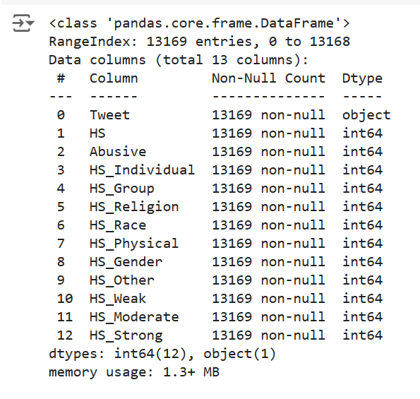
# datatypes check

Slide 8
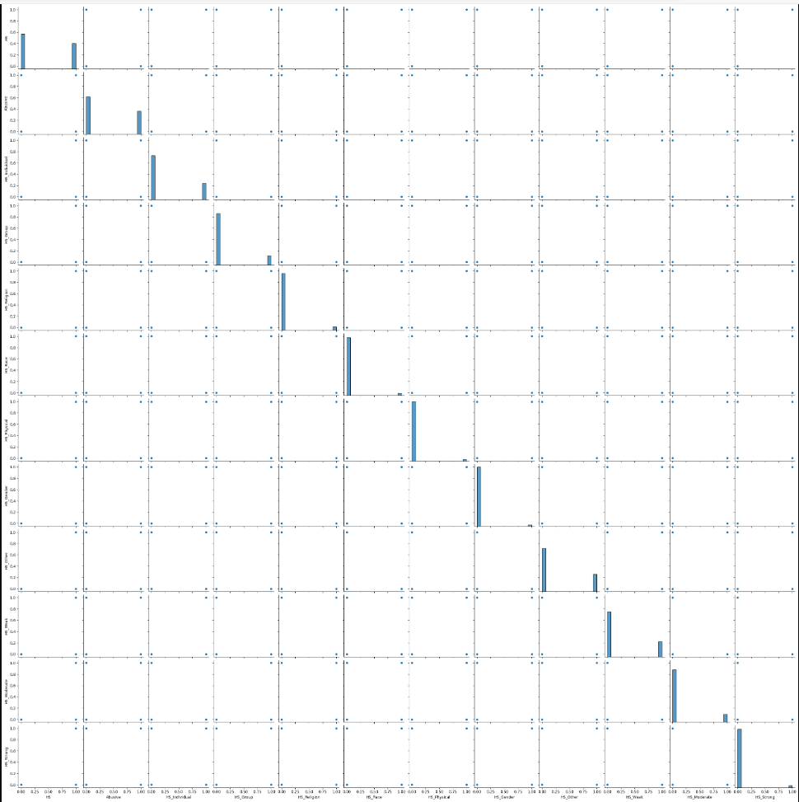
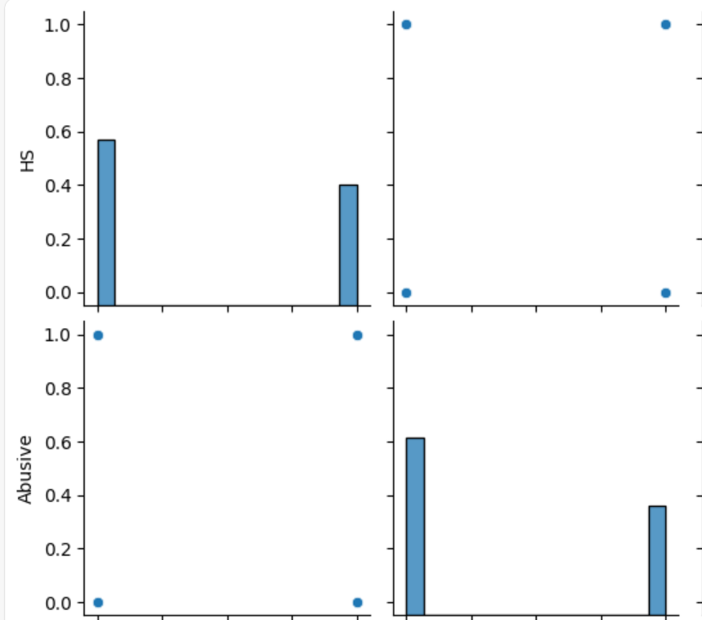
# Value Count

Slide 9
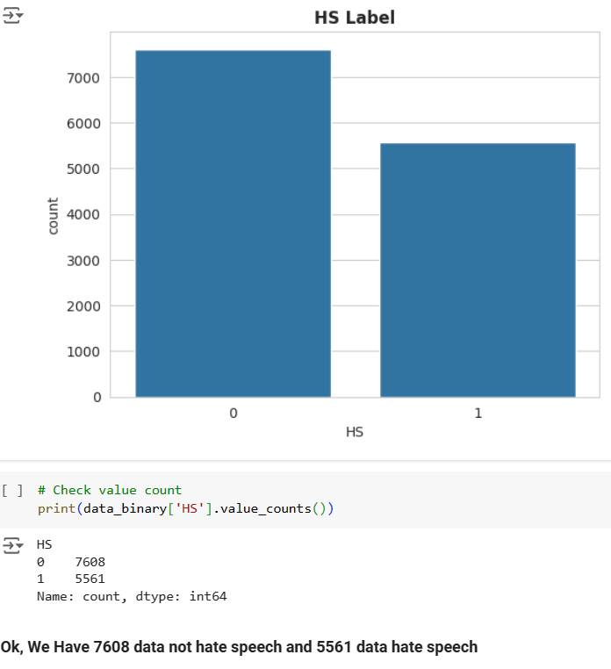
# Let's check total of label hate speech and not hate speech

Slide 10
TEXT PROCESSING
Filtering Data :
Remove number, stock market tickers like $GE, old style retweet text “RT”,
hashtags, hyperlinks, coma, punctuation, emoticon, lower.
2. Tokenization = TweetTokenizer, stopwords_indonesia
3. Stemmer, use library Sastrawi
4. TF-IDF = CountVectorizer, TfidfTransformer

Slide 11
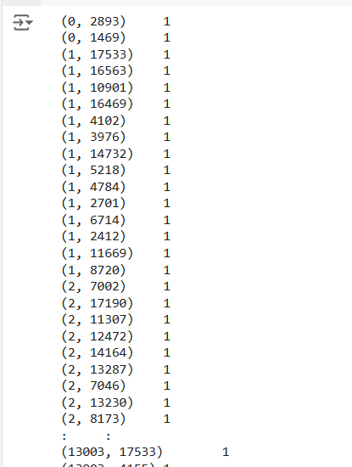
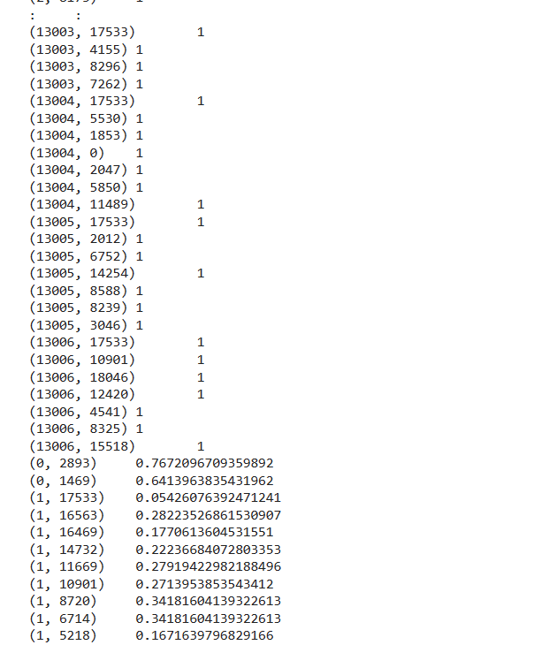
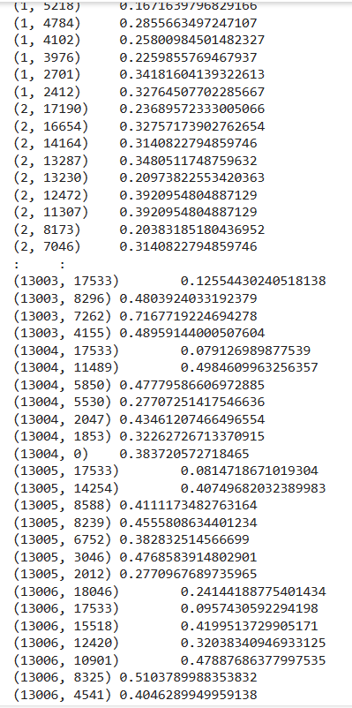
Output TF-IDF

Slide 12
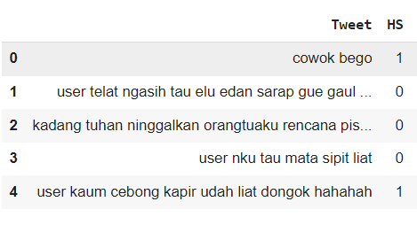
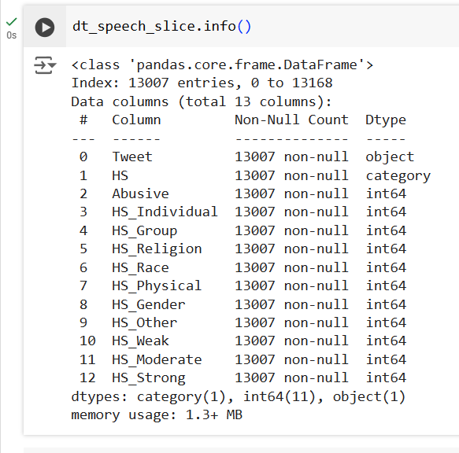
After Filtering and Stemming

Slide 13
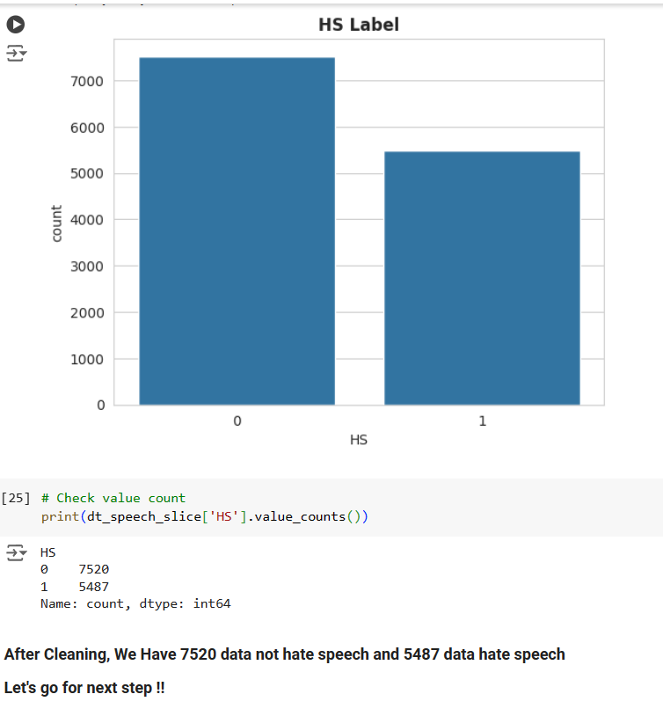

Slide 14
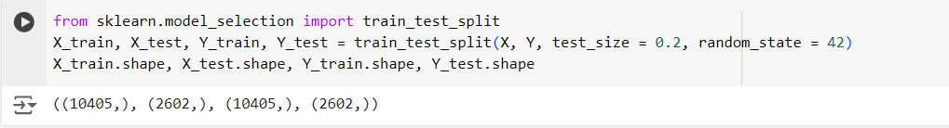
Training Test Split

Slide 15
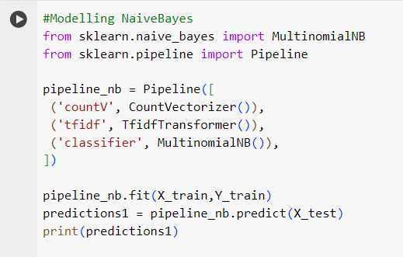
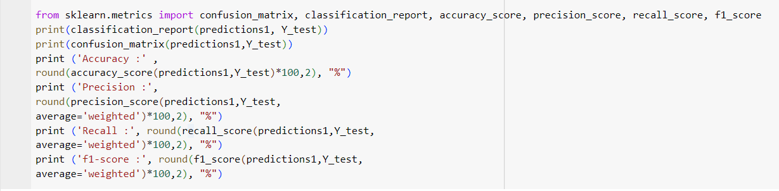
Build Naïve Bayes Algorithm

Slide 16
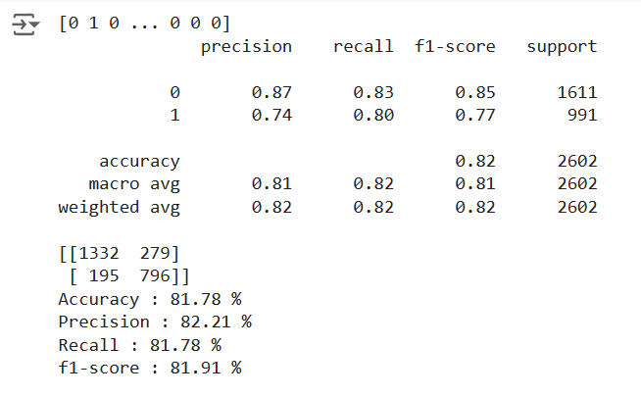
Accuracy of Method/Algorithm and Tools
1. NaiveBayes
Before with parameter naïve bayes
1332+796 = 2128

Slide 17
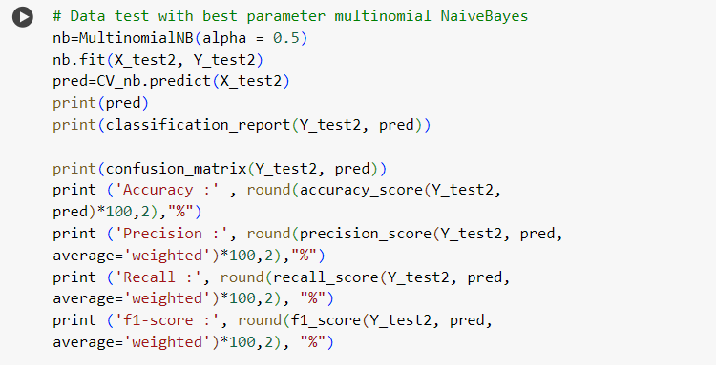
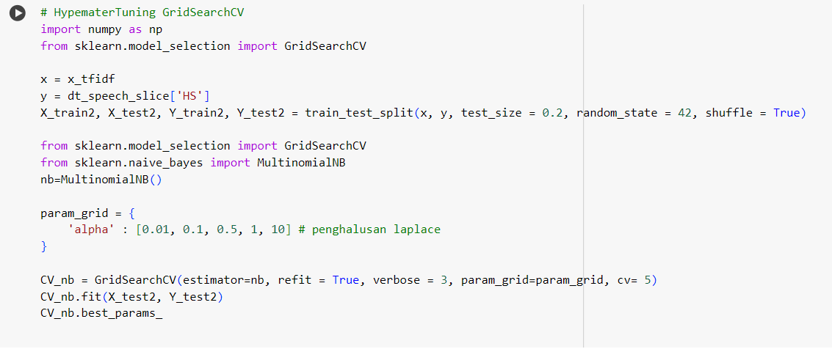
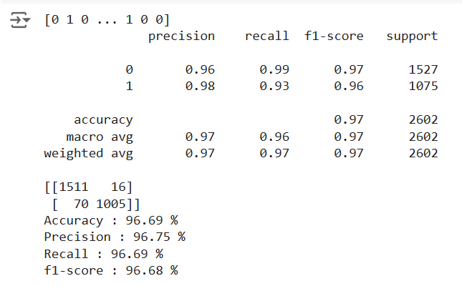
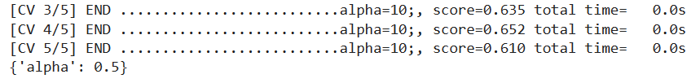
Accuracy of Method/Algorithm and Tools
# HypematerTuning Naïve Bayes with GridSearchCV
1511+1005 = 2516

Slide 18
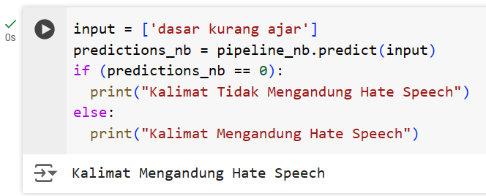
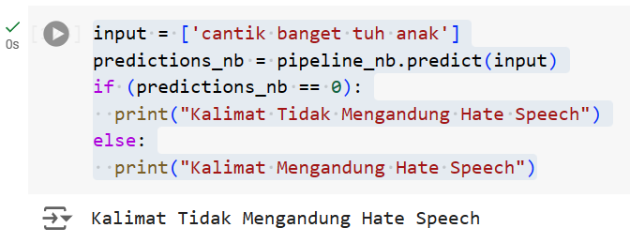
Test input word in indonesian
Hate Speech = 1
Non Hate Speech = 0

Slide 19
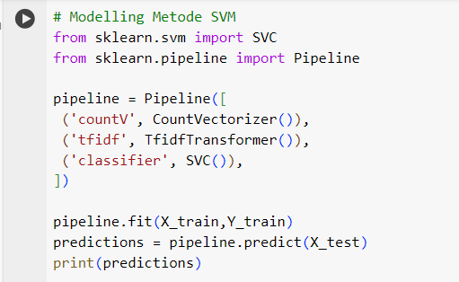
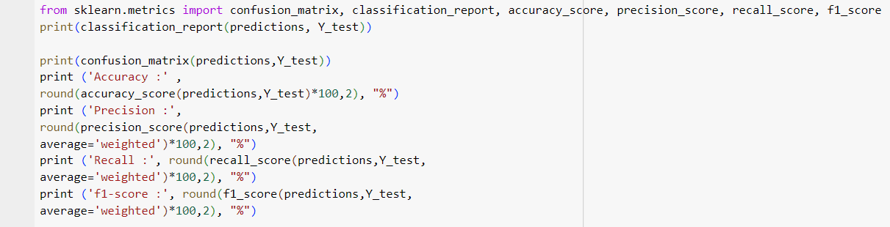
Build SVM Algorithm

Slide 20
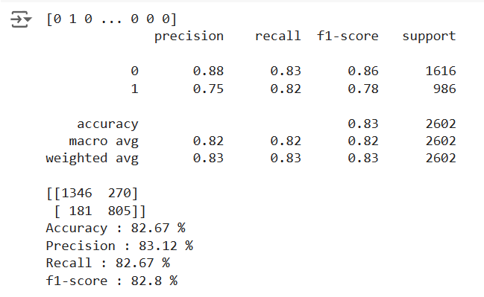
Accuracy of Method/Algorithm and Tools
2. SVM
Before with parameter SVM
1346+805 = 2151

Slide 21
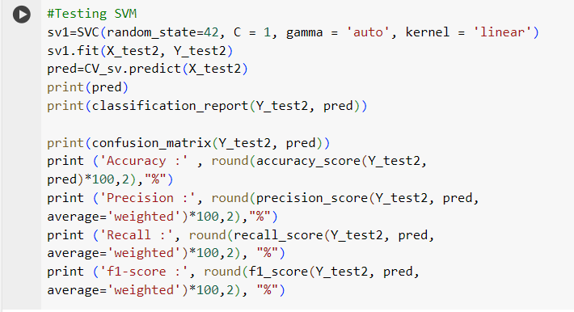
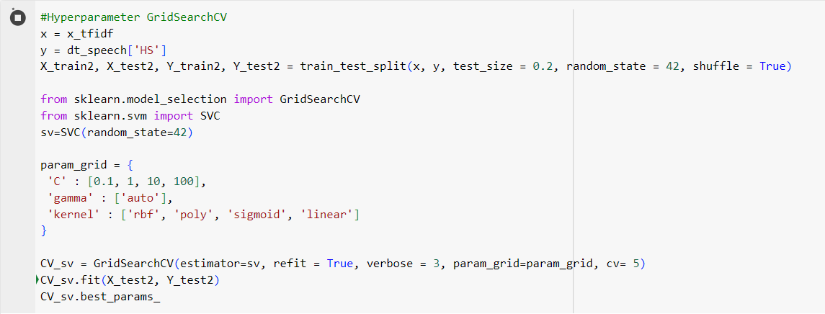
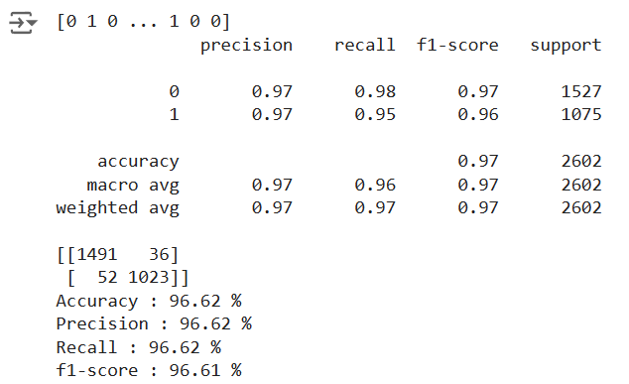
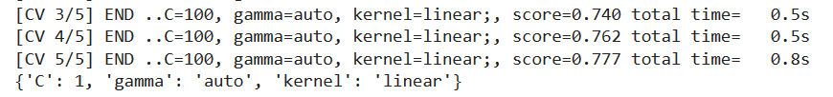
Accuracy of Method/Algorithm and Tools
# HypematerTuning SVM with GridSearchCV
1491+1023 = 2514

Slide 22
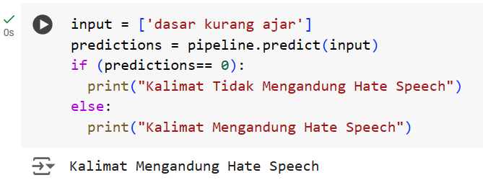
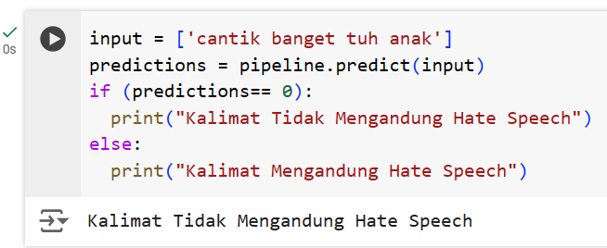
Test input word in indonesian
Hate Speech = 1
Non Hate Speech = 0

Slide 23

Insights
We can distinguish between HateSpeech and non HateSpeech by inputting data containing both categories.
We can best parameter for algorithm between SVM and NaïveBayes using Hyperparameter tuning with GridSearch CV
We can determine the accuracy of the best algorithm between SVM and NaïveBayes. The best one is NaïveBayes.
SVM with accuracy
96.62 %
NB with accuracy
96.69 %

Slide 24

ANALYSIS
Preprocessing techniques are used Filtering Data, Tokenization, Stemmer, and TF-IDF
Algorithms are used CVM and NaïveBayes.
Creating a console to test new sentences, whether the model can detect HateSpeech or not.
INSIGHT
The best algorithm is NaïveBayes.
NEXT STEPS
Experimenting with different algorithms or improving existing ones to enhance model performance.
Summary

Slide 25
Thank you!
ANY QUESTIONS?

